Slide 1
UE DEEP Learning
2023
TransUNet:Transformers Make Strong Encoders for Medical Image Segmentation
Santiago Quinteros
Sofia Pistone

Slide 2
Index
The model
1.1 The model
2.2 Starting point
2.3 Objective
Tests
2.1 How to test
2.2 Test for different number of epochs
2.3 Test for different number of skips
2.4 The impact of the input image size (resolution)
2.5 Influence of Patch Size
Results

Slide 3
1. The model

Slide 4
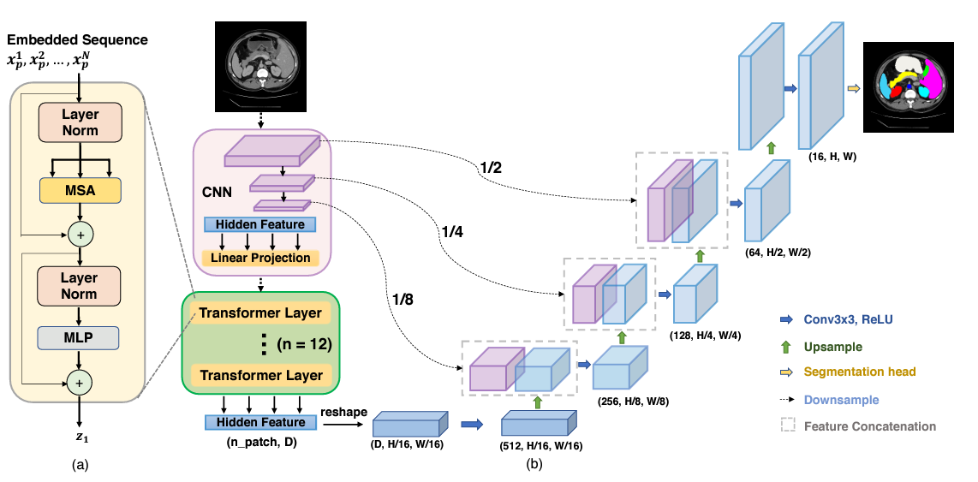
1. The model:
1.1 TransUNet
Concept: Using transformers as encoders in a UNet
Why: allows modeling explicit long-range relation, which is not the case for CNNs

Slide 5
1. The model:
1.1 The relevance of skip connections
Skip connections allow a direct flow of information from the encoding layers to the decoding layers.
This helps to ensure that detailed, low-resolution information that is lost during dimensionality reduction in the encoding layers can be recovered in the decoding layers.
More skip connections =
+ more preservation of local details and features
- Increase in the complexity of the architecture.

Slide 6
1. Contexte :
2.2 Starting point
Data Set:
Characteristics: multi-organ labeled CT images of 512x512x(85∼198).
Training command:
CUDA_VISIBLE_DEVICES=0 python train.py --dataset Synapse --vit_name R50-ViT-B_16
Problems:
Running out of RAM.
Training takes a whole class to run.
Solution: Reduce the batch_size to 6 reduced the epochs to 15
Notes:
Desventajas de un tamaño de lote pequeño:
Mayor variabilidad en las actualizaciones: Las actualizaciones de peso son más frecuentes pero más ruidosas, ya que se basan en un subconjunto más pequeño de datos.
Posiblemente requiere más tiempo de entrenamiento: Aunque las actualizaciones son más frecuentes, puede llevar más tiempo completar un número suficiente de iteraciones.
El tamaño del lote, o batch_size, se refiere al número de ejemplos de entrenamiento utilizados en una iteración para actualizar los pesos de un modelo durante el entrenamiento. En el contexto de aprendizaje profundo y redes neuronales, el entrenamiento se realiza típicamente mediante el descenso del gradiente estocástico (SGD) o sus variantes. Aquí hay una explicación más detallada:
Descenso del gradiente estocástico (SGD):
En lugar de actualizar los pesos del modelo utilizando el gradiente calculado sobre el conjunto completo de datos de entrenamiento (descenso del gradiente por lotes o batch gradient descent), el SGD actualiza los pesos después de cada lote de datos. Esto hace que el proceso sea más eficiente en términos computacionales.
Normalmente en clase usábamos el batch size de todo a la vez.

Slide 7
1. Contexte :
2.2 Starting point
Test command:
python test.py --dataset Synapse --vit_name R50-ViT-B_16
Problem:
Tests take a lot of space in the Hard drive
Solution: migration to Google colab.

Slide 8
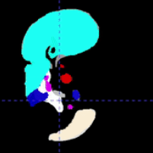
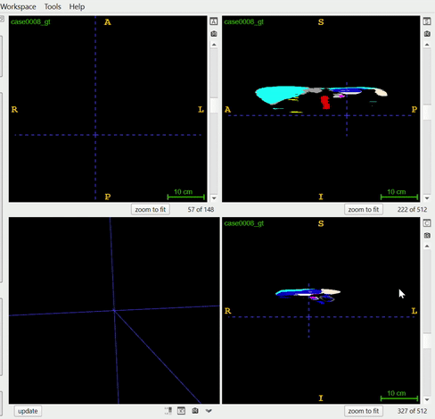
1. Context :
2.3 Objective
First inference successfully generated!
But the results are poor due to the low number of epochs (15) and the default parameters
Objective: find the best hyper-parameters of the model
to understand the network
to have the best segmentations with limited time and without a super computer.

Slide 9
2. Tests

Slide 10
2. Tests:
2.1 How to test
We made a script that performs numerous tests of your choice without the need for a user to run them manually.
We made a script that saves the relevant information and automatically deletes the old models to avoid space problems.
We change the output so that instead of being done by console, it is done in a csv file and the graphics are done easily.

Slide 11
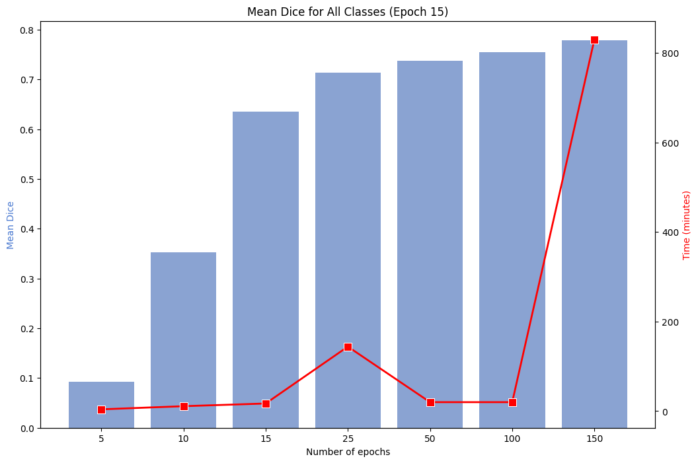
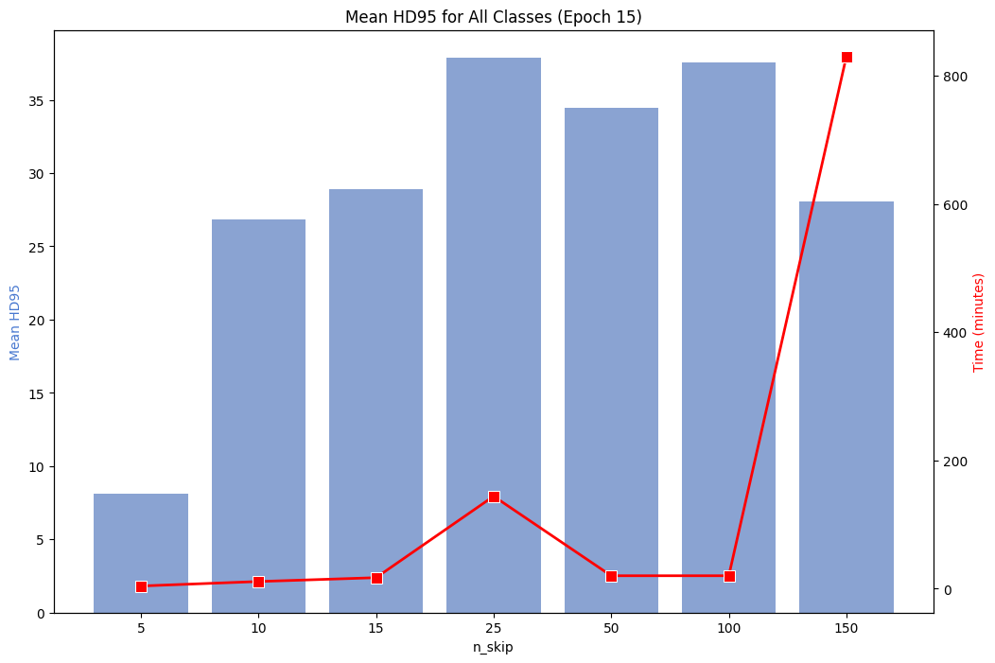
2. Tests:
2.2 Test for different number of epochs
As expected, the dice score improved as we added epochs, but also considerably the training time.
The difference in dice score between 15 epochs and 150 is not crucial, so we will do the tests with 15 epochs
Notes:
Incluso cuando el Dice_score promedio se redujo para

Slide 12
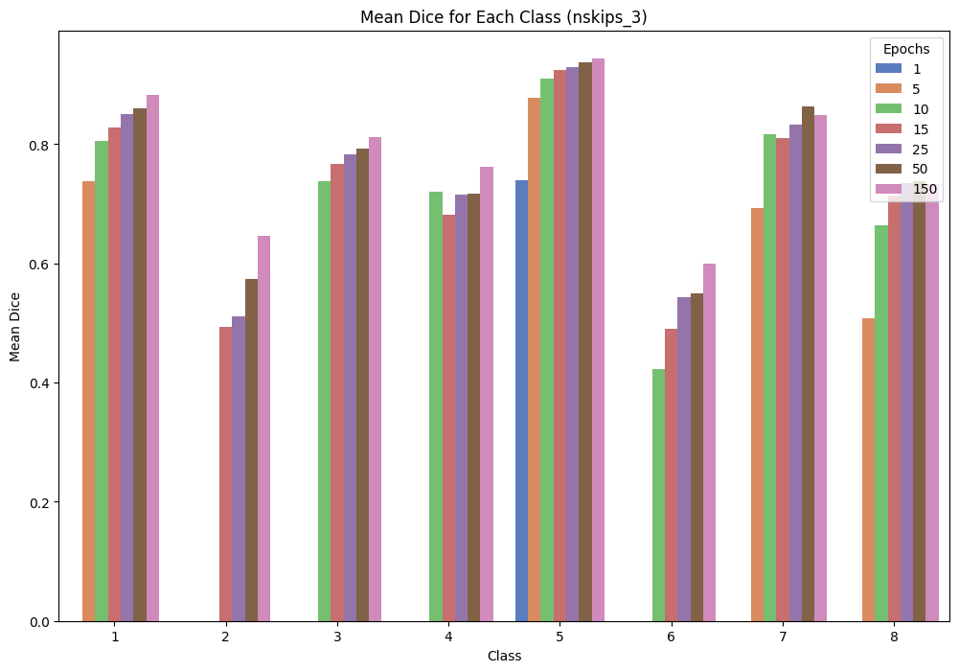
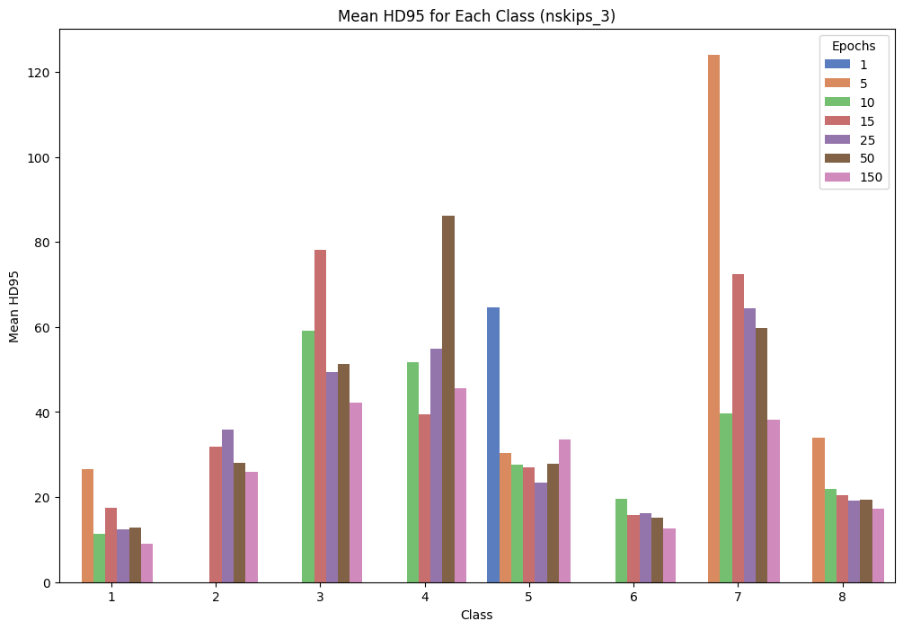
2. Tests:
2.2 Test for different number of epochs
Evidently the dice_score was lower the higher the number of epochs.
Likewise the Hausdorff distance was lower the higher the number of epochs.
We note that the dice score is not much lower for 15 epochs than for 150 epochs and takes much less time. This is why we will use 15 epochs for the following tests.
Notes:
Incluso cuando el Dice_score promedio se redujo para

Slide 13
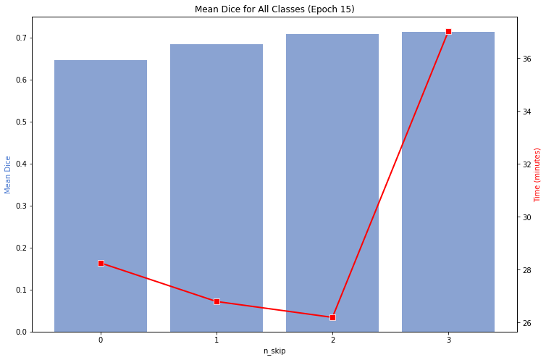
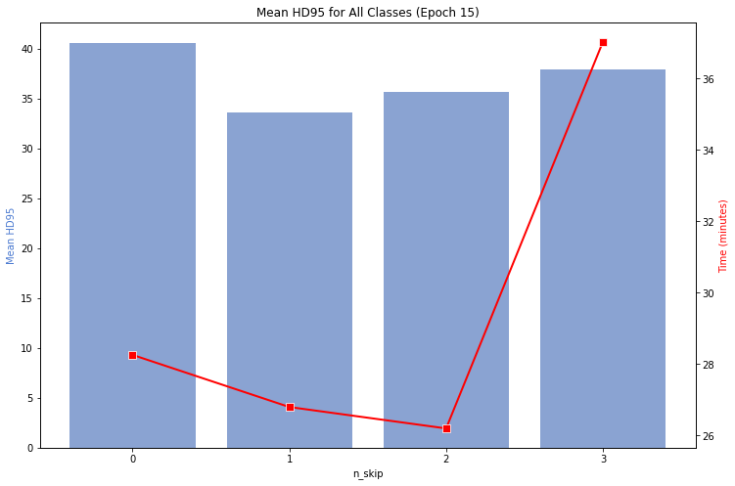
2. Tests:
2.3 Test for different number of skip connections
As expected, the dice score improved as we added skip connections.
But training takes twice as long.
Adding more skip connections could be a good idea, although the training time would increase considerably.
Notes:
Incluso cuando el Dice_score promedio se redujo para

Slide 14
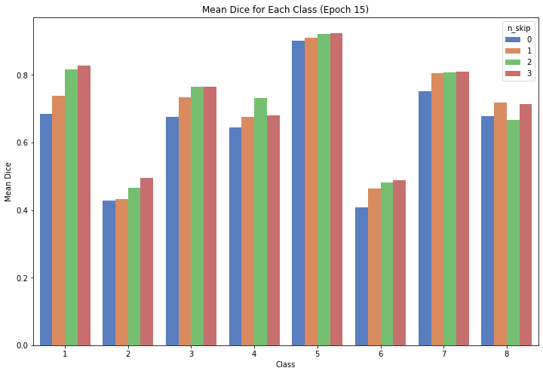
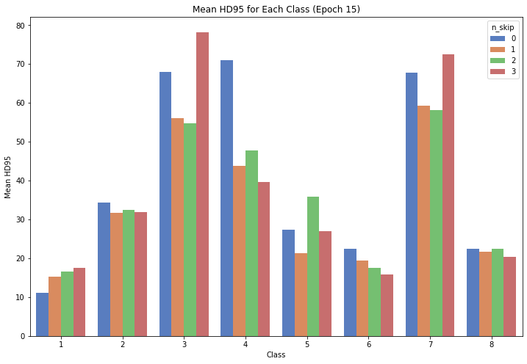
2. Tests:
2.3 Test for different number of skip connections
Using 3 skip connections improves segmentation by 10%. This shows the great value of this approach versus using a transformer and decoding directly.
Notes:
Incluso cuando el Dice_score promedio se redujo para

Slide 15
2. Tests:
2.4 The impact of the input image size (resolution)
Until now we have been using a lower resolution than the original for faster processing.
It is expected that using larger images will give better results, however, the higher the resolution, the more features the model has to take into account, the more RAM it consumes and the longer it takes to train.
Indeed, we couldn't finish this test as RAM memory reached its maximum capacity.
Notes:
Incluso cuando el Dice_score promedio se redujo para

Slide 16
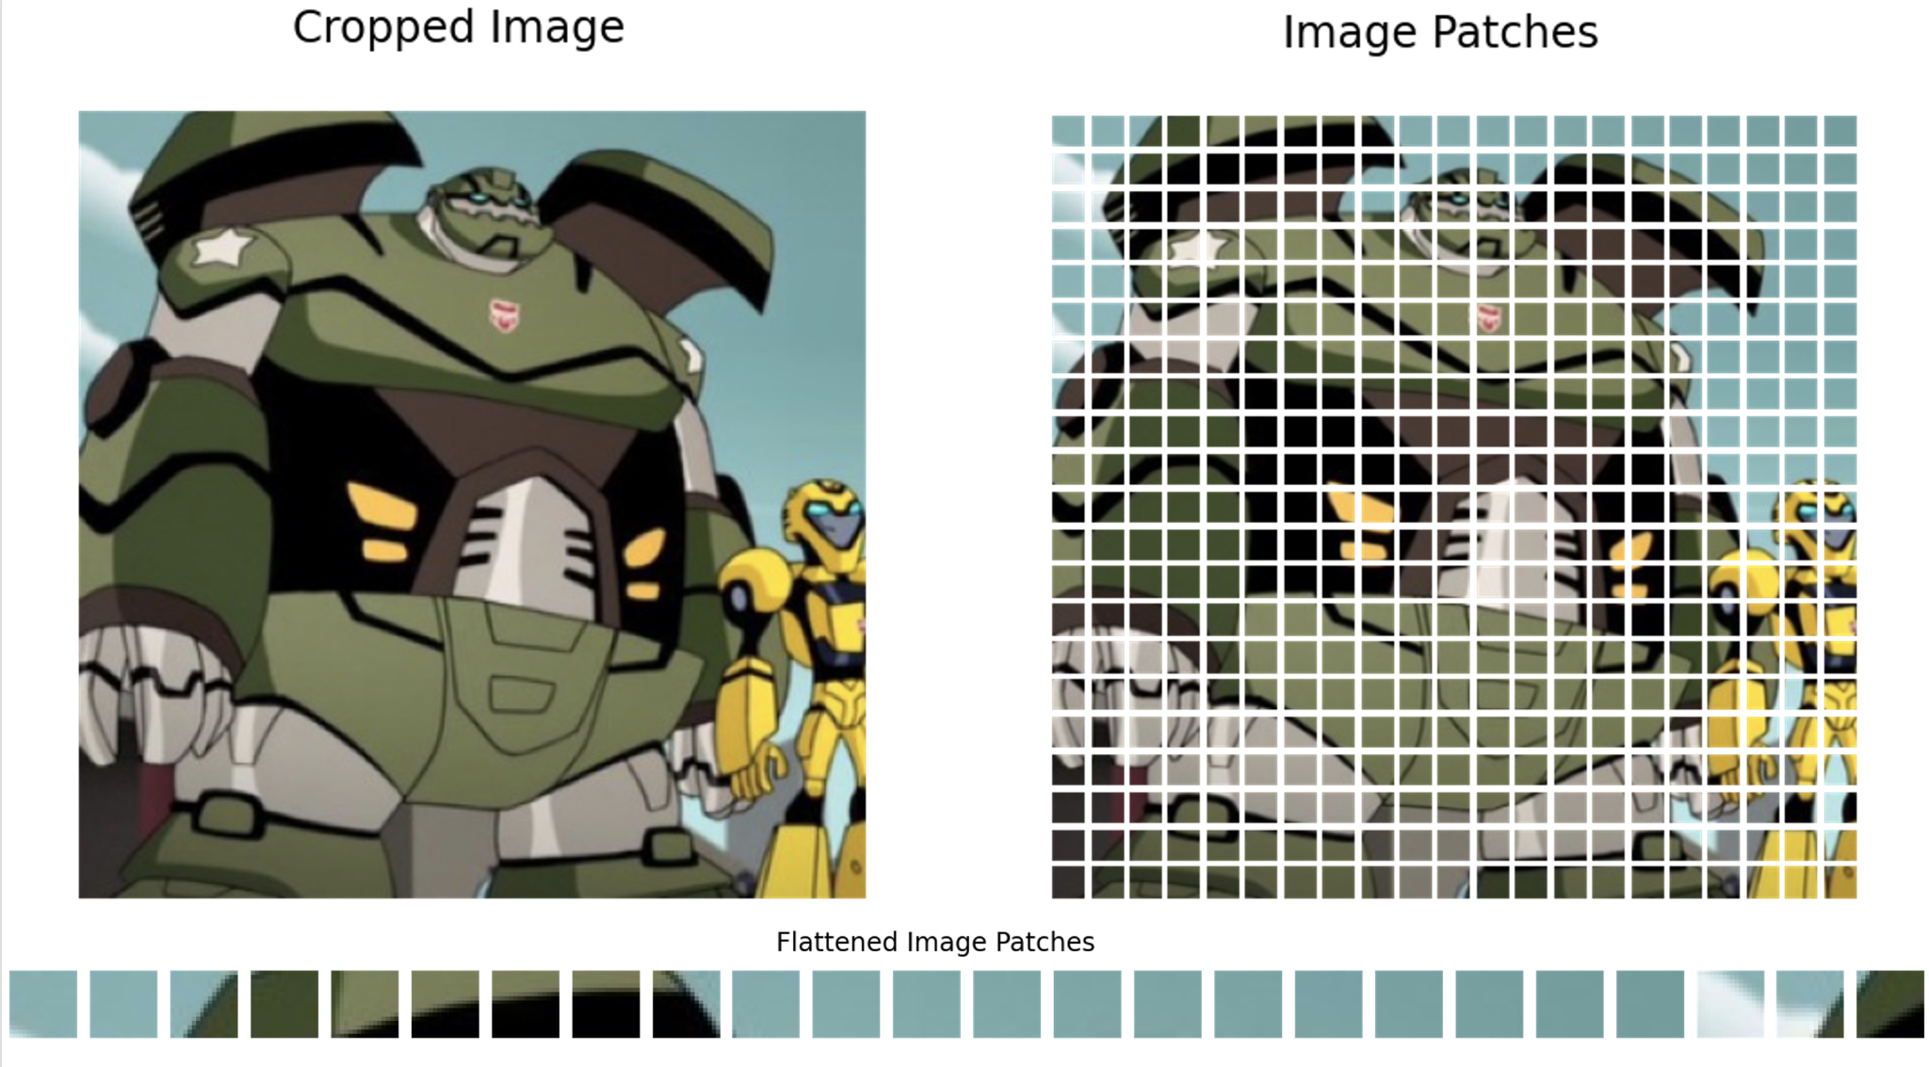
2. Tests:
2.5 Influence of Patch Size
Possible improvement for the tests:
Dividing the image into patches allows the use of transformers to capture the relationships between different parts of the image.
Using larger patches captures less detail but greatly simplifies the model allowing for faster training.
Notes:
Incluso cuando el Dice_score promedio se redujo para

Slide 17
3. Results

Slide 18
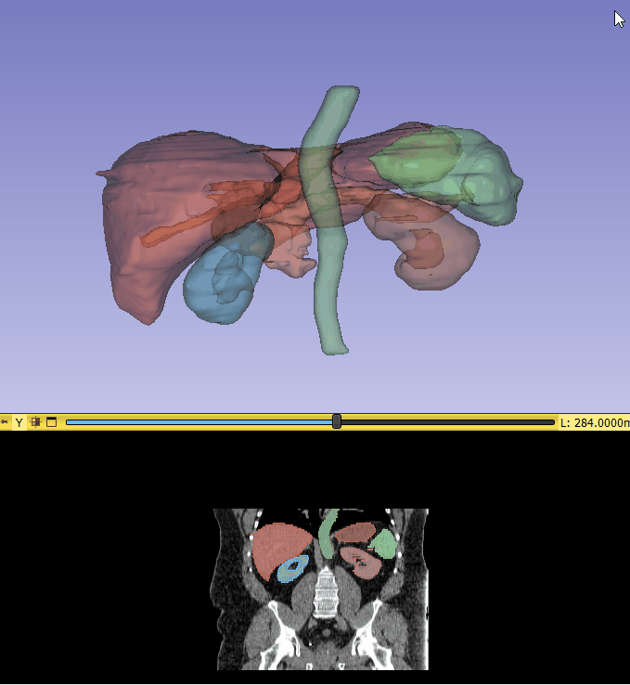
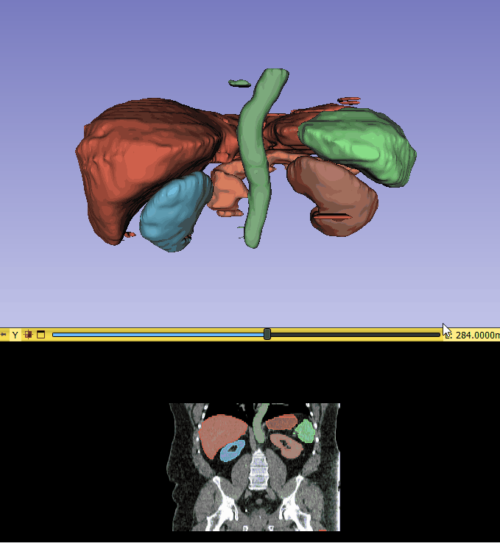
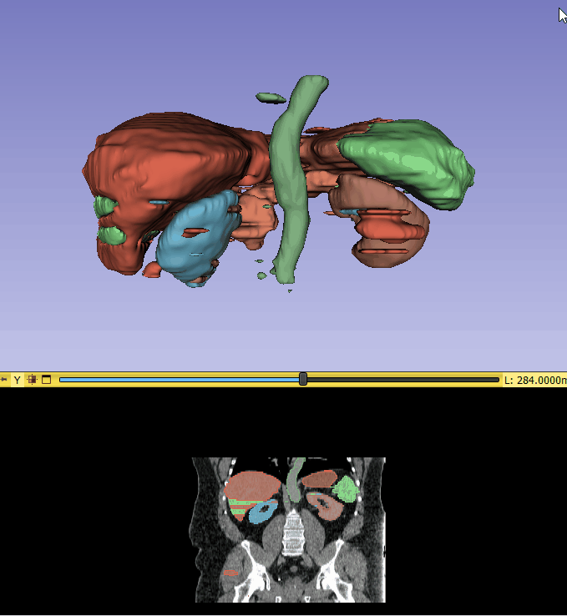
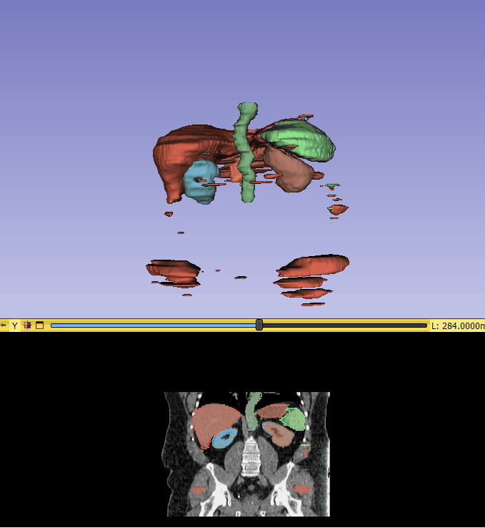
3. Results :
Interactive visual comparison for patient 38
Ground truth
150 epochs 3 skip
20 epochs 3 skip
20 epochs 0 skip

